Slide 1

Getting Started with MATLAB
03. Data Structures:
Cell Arrays and Structures
Vahid Naeini
E-mail: naeini.v@gmail.com

Slide 2
Data structures
Data structures are variables that store more than one value.
A cell array is a kind of data structure that stores values of different types.
Structures are data structures that group together values that are logically related, but are not the same thing and not necessarily the same type.
  The different values are stored in separate ﬁelds of the structure.
Name | ID | Dept. | Course. | Semester | Quiz score
‘Jeff’ | 1234 | ‘Mech.’ | ‘Thermo’ | ‘FALL 2013’ | 10
Getting Started with MATLAB / 03. Data Structures: Cell Arrays and Structures/ V.Naeini

Slide 3
Cell Arrays
>> % cell row vector >> cellrowvec = {23, 'a', 1:2:9, 'hello'} cellrowvec = [23] 'a' [1x5 double] 'hello'
>> % cell column vector >> cellcolvec = {23; 'a'; 1:2:9; 'hello'} cellcolvec = [ 23] 'a' [1x5 double] 'hello'
>> % 2x2 cell array matrix >> cellmat = {23 'a'; 1:2:9 'hello'}
Getting Started with MATLAB / 03. Data Structures: Cell Arrays and Structures/ V.Naeini

Slide 4
Cell Arrays
>> % type of cell arrays is cell >> class(cellmat) ans = cell
Getting Started with MATLAB / 03. Data Structures: Cell Arrays and Structures/ V.Naeini

Slide 5
Cell Arrays
To preallocate a variable (create an empty cell)
>> mycellmat = cell(2,2) mycellmat = [] [] [] []
Getting Started with MATLAB / 03. Data Structures: Cell Arrays and Structures/ V.Naeini

Slide 6
Cell Arrays
Referring to and Displaying Cell Array Elements
>> cellrowvec{2} ans = a
>> cellmat{1,1} ans = 23
>> mycellmat{1,1} = 23 mycellmat = [23] [] [] []
Getting Started with MATLAB / 03. Data Structures: Cell Arrays and Structures/ V.Naeini

Slide 7
Cell Arrays
Use {}
>> cellmat(2,1) %cell indx shows type ans = [1x5 double] >> cellmat{2,1} ans = 1 3 5 7 9
>> cellmat{2,1}(4) ans = 7
Getting Started with MATLAB / 03. Data Structures: Cell Arrays and Structures/ V.Naeini

Slide 8
Cell Arrays
Call multiple subsets of a cell array
>> cellcolvec{2:3} ans = a ans = 1 3 5 7 9
>> [c1, c2] = cellcolvec{2:3} c1 = a c2 = 1 3 5 7 9
Getting Started with MATLAB / 03. Data Structures: Cell Arrays and Structures/ V.Naeini

Slide 9
Cell Arrays
The celldisp function displays the contents of all elements of the cell array
>> celldisp(cellrowvec) cellrowvec{1} = 23 cellrowvec{2} = a cellrowvec{3} = 1 3 5 7 9 cellrowvec{4} = hello
Getting Started with MATLAB / 03. Data Structures: Cell Arrays and Structures/ V.Naeini

Slide 10

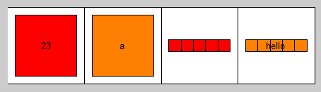
Cell Arrays
The function cellplot puts a graphical display of the cell array into a Figure Window
>> cellplot(cellrowvec)
>> cellplot(cellcolvec)
Getting Started with MATLAB / 03. Data Structures: Cell Arrays and Structures/ V.Naeini

Slide 11
Cell Arrays
Storing Strings in Cell Arrays
>> names = {'Sue', 'Cathy', 'Xavier'} names = 'Sue' 'Cathy' 'Xavier'
>> names(2) ans = 'Cathy'
>> %pick two people, randomly >> personindx = randi([1 3],1,2) personindx = 2 1 >> names(personindx ) ans = 'Cathy' 'Sue'

Slide 12

“Lady Gaga” as a MATLAB programmer
>> S = {'ra', 'ah','ma', 'ga', 'la', 'oh'}; >> SoundNum = length(S);
>> randPoemIndx = ... [1 1 2 2 2 1 3 1 3 3 4 4 6 5 5] randPoemIndx = 1 1 2 2 2 1 3 1 3 3 4 4 6 5 5
>> S(randPoemIndx) ans = ‘ra’ ‘ra’ ‘ah’ ‘ah’ ‘ah’ ‘Ra’ ‘ma’ ‘ra’ ‘ma’ ‘ma’ ‘ga’ ‘ga’ ‘oh’ ‘la’ ‘la’
Getting Started with MATLAB / 03. Data Structures: Cell Arrays and Structures/ V.Naeini

Slide 13
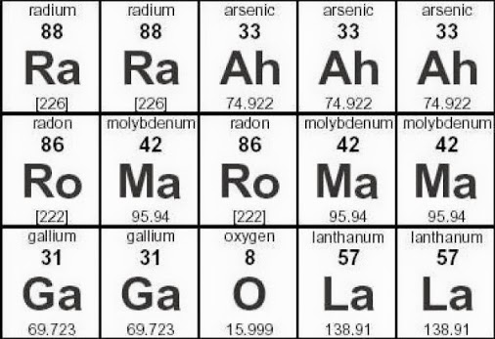

Another Possibility:
Apparently it won some awards, …
wait … WHAT???
Getting Started with MATLAB / 03. Data Structures: Cell Arrays and Structures/ V.Naeini

Slide 14
Structures
Structures are data structures that group together values that are logically related in what are called ﬁelds of the structure.
package
item_no | cost | price | code
123 | 19.99 | 39.95 | g
>> package = struct('item_no',123,'cost',19.99, ... 'price',39.95,'code','g') package = item_no: 123 cost: 19.9900 price: 39.9500 code: 'g'
Getting Started with MATLAB / 03. Data Structures: Cell Arrays and Structures/ V.Naeini

Slide 15
Structures
OR, you can use dot (.) operator:
Also you can change record values via this method
Dot operator is not as efficient. (Not recommended for big data processing)
>> package.item_no = 123; >> package.cost = 19.99; >> package.price = 39.95; >> package.code = 'g';
>> package.cost = 17.99
Getting Started with MATLAB / 03. Data Structures: Cell Arrays and Structures/ V.Naeini

Slide 16
Structures
Remove a field of structure:
Check for being structure or field (return true or false):
>> % remove code filed from package structure >> rmﬁeld(package, 'code')
>> isstruct(package) ans = 1 >> isﬁeld(package,'cost') ans = 1
Getting Started with MATLAB / 03. Data Structures: Cell Arrays and Structures/ V.Naeini

Slide 17
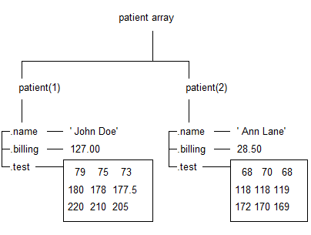
Vectors of Structures
Image source: http://stackoverflow.com/questions/24828528/empty-all-the-fields-of-a-structure-array-in-matlab
Getting Started with MATLAB / 03. Data Structures: Cell Arrays and Structures/ V.Naeini

Slide 18
Vectors of Structures
packages
item_no | cost | price | code
123 | 19.99 | 39.95 | g
456 | 5.99 | 49.99 | l
587 | 11.11 | 33.33 | w
>> packages = struct('item_no',123,'cost',19.99,... 'price',39.95,'code','g'); >> packages(2) = struct('item_no',456,'cost', 5.99,... 'price',49.99,'code','l'); >> packages(3) = struct('item_no',587,'cost',11.11,... 'price',33.33,'code','w');
Getting Started with MATLAB / 03. Data Structures: Cell Arrays and Structures/ V.Naeini

Slide 19
Vectors of Structures
>> packages(2) ans = item_no: 456 cost: 5.9900 price: 49.9900 code: 'l'
Getting Started with MATLAB / 03. Data Structures: Cell Arrays and Structures/ V.Naeini

Slide 20
Vectors of Structures
>> %prints all costs based on vector index >> packages.cost ans = 19.9900 ans = 5.9900 ans = 11.1100
>> pc = [packages.cost] %stored in a vector pc = 19.9900 5.9900 11.1100
>> sum([packages.cost]) ans = 37.0900
Getting Started with MATLAB / 03. Data Structures: Cell Arrays and Structures/ V.Naeini

Slide 21
Practice: Vectors of Structures
student
name | id_no | quiz
 |  | 1 | 2 | 3 | 4
Ross | 1234 | 10.0 | 10.0 | 9.5 | 10.0
Joey | 2345 | 3.0 | 5.0 | 2.5 | 6.0
Monica | 3456 | 7.5 | 8.5 | 9.5 | 10.0
Chandler | 4567 | 8.5 | 9.5 | 9.5 | 6.5
Phoebe | 5678 | 6.0 | 5.0 | 4.0 | 8.0
Rachel | 6789 | 5.0 | 7.5 | 8.0 | 9.5
>> student(3) = struct('name',‘Monica',... 'id_no',3456,'quiz', [7.5 8.5 9.5 10.0]);
>> >> student(2).quiz(1) ans = 3.0000
Getting Started with MATLAB / 03. Data Structures: Cell Arrays and Structures/ V.Naeini

Slide 22
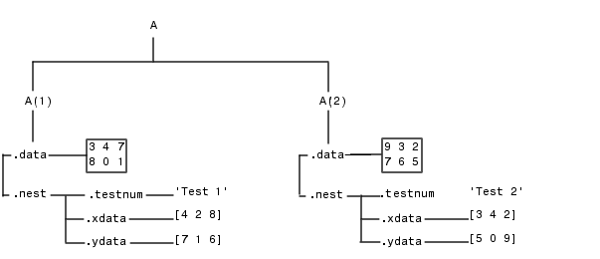

Vectors of Nested Structures
Image source: http://matlab.izmiran.ru/help/techdoc/matlab_prog/ch_da35a.html
Getting Started with MATLAB / 03. Data Structures: Cell Arrays and Structures/ V.Naeini

Slide 23
Nested Structures
A nested structure is a structure in which at least one member is itself a structure.
triangle
point1 |  | point2 |  | point3
x | y | x | y | x | y
0 | 0 | 10 | 0 | 0 | 10
>> triangle = struct('point1',struct('x',0,'y',0), ... 'point2', struct('x',10,'y',0), ... 'point3', struct('x',0,'y',10)) triangle = point1: [1x1 struct] point2: [1x1 struct] point3: [1x1 struct]
Getting Started with MATLAB / 03. Data Structures: Cell Arrays and Structures/ V.Naeini

Slide 24
Nested Structures
>> triangle.point2.x ans = 10 >> triangle.point1.y ans = 0
Getting Started with MATLAB / 03. Data Structures: Cell Arrays and Structures/ V.Naeini

